Slide 1
NBAC TSC Slides 27 June 2024 Meeting

Slide 2
27 June 2024 NBAC TSC Agenda
1:00 NBAC Co-Chair Opening Remarks – Mr. Kamran Atri & Thomas Krul
Work will commence soon on completing the PS02 update to Model Version 6.0
Dr. Renner is working on the companion NDR update for Model Version 6.0
NIEMOpen Reveal Summit preps are in progress
1:05 NIEM Management Office (NMO) Update – Ms. Katherine Escobar
NIEMOpen Reveal
Link to Website : https://niemopen.org/reveal
Ways Your Company Can Participate:
Reserve seats for your key staff to attend the conference.
Organize a team to participate in the hackathon, contact: Jane Harnad.
Sponsor the event early to secure one of the limited number of sponsor tables, contact: Jane Harnad.
1:15 NTAC Update – Dr. Scott Renner
CMF Tool: https://github.com/niemopen/cmftool
NDR draft: “ndr6-outline.md” at https://github.com/niemopen/niem-naming-design-rules/tree/dev
1:25 Communications & Outreach NMO Sub-Committee update – Paul Wormeli
1:35 Community Updates - all
1:40 Questions/Final Remarks

Slide 3


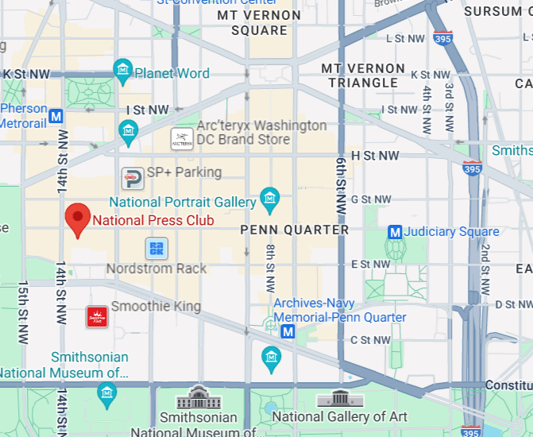

NIEMOpen reveal summit : 18-20 Feb 2025
Event Website: https://niemopen.org/reveal
Direct Registration Link: https://www.eventbrite.com/e/niemopen-reveal-training-summit-2025-tickets-890279729637
Homepage | National Press Club
Located in: National Press Building
Address: 529 14th St NW, Washington, DC 20045
Founded: March 29, 1908
Phone: (202) 662-7500

Slide 4








resources
Follow Us On Twitter
https://twitter.com/NIEMconnects?ref_src=twsrc%5Etfw
Katherine Escobar, katherine.b.escobar.civ@mail.mil, 7575-203-8631
Beth Smalley, beth.l.smalley.civ@mail.mil, 757-203-7177
Stephen Sullivan, stephen.m.sullivan14.ctr@mail.mil , 757-203-8619
https://www.niem.gov/
https://niemopen.org/
https://www.linkedin.com/groups/1903175/profile
Git Repos
NIEMOpen: https://github.com/niemopen/
NTAC TSC
https://github.com/niemopen/ntac-admin
NBAC TSC
https://github.com/niemopen/nbac-admin
NMO TSC
https://github.com/niemopen/nmo-admin
https://github.com/niemopen/nmo-training
NIEMOpen Slack Channel: https://niemopen.slack.com/
Mailing Lists
NIEMOpen: https://lists.oasis-open-projects.org/g/niemopen
PGB: https://lists.oasis-open-projects.org/g/niemopen-pgb
NTAC TSC: https://lists.oasis-open-projects.org/g/niemopen-ntactsc
NBAC TSC: https://lists.oasis-open-projects.org/g/niemopen-nbactsc
NMO TSC: https://lists.oasis-open-projects.org/g/niemopen-nmotsc
https://www.youtube.com/channel/UCg9qV22PXLBjG41hc-EwVrQ
MEP Registry & Repository
MEP Tool: https://mep.niemopen.org
CMFTool: https://github.com/niemopen/cmftool
NDR draft: “ndr6-outline.md” at https://github.com/niemopen/niem-naming-design-rules/tree/dev

Slide 5
Resources-Repos
NIEMOpen GitHub Repos
A directory for the NIEMOpen GitHub repositories is provided below, with descriptions available as tooltips on the links.
The transition of repositories from the NIEM GitHub account to the new niemopen GitHub account is in progress. Links to the original NIEM repos have been temporarily provided while content, open issues, and wiki pages are still being contributed.
NIEMOpen OASIS Open Project
Technical Steering Committees
NIEM Business Architecture Committee (NBAC)
NIEM data model issue tracker (GitHub)
NBAC task tracker (Jira)
NIEM Technical Architecture Committee (NTAC)
NTAC meeting agendas and minutes
NTAC issue tracker (GitHub)
NTAC discussion board (GitHub)
NIEM Management Office (NMO)

Slide 6
Resources-Repos
Specifications
NIEM model
Naming and Design Rules (NDR) | original repo | JSON Spec 5.0 markdown
Message Specifications | original MPD-Spec repo | IEPD Spec 5.0 markdown
Code Lists | original repo
Common Model Format (CMF)
Conformance | original repo
Conformance Targets Attribute Specification (CTAS)
Resources
niem.github.io | original repo
Template IEPD | original repo
Training | original repo
Tools
CMF Tool
IEPD Java Bindings | original repo
NIEM API | original repo

